Slide 1

School of Computer Engineering
Dynamic video based human authentication system.
Guide: Dr. Sunita Barve
081 Aditi Pandey
086 Rutik Pol
070 Mrunmai Bhole

Slide 2
Problem Statement
Video Based Dynamic Human Authentication System For Access Control.

Slide 3
Motivation
Various biometric features can be used for the purpose of human recognition like fingerprint, palm print, hand geometry, iris, face, speech, signature etc.
The problem with finger print, iris palm print, speech, are they need active co-operation of person while face recognition is a process does not require active co-operation of a person, so without instructing the person can recognize the person.
So face recognition is much more advantageous compared to the other biometrics.

Slide 4
Introduction
Machine recognition of faces is gradually becoming very important due to its wide range of commercial and law enforcement applications, which include authentication system with low cost recording devices.
Face recognition has a high identification or recognition rate of greater than 90% for huge face databases with well-controlled pose and illumination conditions.

Slide 5
Objectives
To detect face using Haar cascade face detection model in OpenCV.
To recognize the face.
A. Feature base approach
In feature based approach the local features like nose, eyes are segmented and it can be used as input data in face detection to easier the task of face recognition.
B. Holistic approach
In holistic approach the whole face taken as the input in the face detection system to perform face recognition.
C. Hybrid approach
Hybrid approach is combination of feature based and holistic approach. In this approach both local and whole face is used as the input to face detection system.

Slide 6
Literature Survey
Sr.no | Title of Paper | Author | Journal | Volume issued | Year of Publication
1. | COMPARISON BETWEEN FACE RECOGNITION ALGORITHM-EIGENFACES, FISHERFACES AND ELASTIC BUNCH GRAPH MATCHING | Sushma Jaiswal, Dr.(Smt.)Sarita SinghBhadauria,Dr. Rakesh Singh Jadon | Journal of Global Research in Computer Science | Volume 2, No. 7 | July 2011
2. | Application of the Karhunen-Loeve procedure for the characterization of human faces | KIRBY, M. AND SIROVICH | IEEE Trans. Patt. Anal. Mach. Intell. 12 |  | 1990

Slide 7
Eigenface
The Eigenface method is one of the generally used algorithm for face recognition. Karhunen-Loeve is based on the eigenfaces technique in which the Principal Component Analysis (PCA) is used. This method is successfully used to perform dimensionality reduction.
A drawback is that it is sensitive for lightening conditions and the position of the head.

Slide 8
Literature Survey
Sr.no | Title of Paper | Author | Journal | Volume issued | Year of Publication
 | Performance Comparison of Various Face Detection Techniques | Mohammed Javed , Bhaskar Gupta | International Journal of Scientific Research Engineering & Technology (IJSRET) | Volume 2 Issue1 pp 019-0027 April 2013 www.ijsret.org ISSN 2278 – 0882 IJSRET | 2013

Slide 9
Literature Survey
Sr.no | Title of Paper | Author | Journal | Volume issued | Year of Pub;i
1. | Human face detection in color images using skin color and template matching models for multimedia on the Web | ] K.; Subban, R.; Krishnaveni, K.; Fred, L.; Selvakumar, R.K Nallaperumal, | IFIP International Conference : Wireless and Optical Communications Networks | pp. 5-10 [17] | 11-13 April 2006
2. | Face recognition: features versus templates | R. Bruneli and T. Poggio | IEEE Trans. Pattern Analysis and Machine Intelligence | vol. 15, pp. 1042-1052 | 1993.

Slide 10
Geometrical feature matching
Geometrical feature matching based on precisely measured distances between features may be useful for finding matches in a large database. However, it will be dependent on the accuracy of the feature location algorithms. Disadvantage of current automated face feature location algorithms do not provide a high degree of accuracy and require considerable computational time.
In 2006 Basavaraj and Nagaraj proposed a geometrical model for facial feature extraction. The basic process includes improvement of frontal face images including ears and chin and also of potential features because it enhances the development of methods in face recognition process
. Similarly in Pavanet al. (2011) presented a geometry based face recognition method which makes use of subspace based models. These models provide geometrical properties of the face space which can assist efficient recognition system for number of image applications.

Slide 11
Template matching
In template matching, we can exploit other face templates from different prospects to characterize single face. Primarily, grey levels that match the face image can also be processed in proper format (Bichsel, 1991). In Bruneli and Poggio (1993) the Pop and Bruneli is available for all aspects of developing automatic four template features i.e., eyes, nose, mouth, face and selecting the entire set.
Primarily, the edginess based face representation is calculated to process one dimensional images. The system is somehow associated with Neural Networks to test the images under varying pose and illumination conditions. A face from a single viewpoint can also be represented by a set of multiple distinctive smaller templates. The face image of gray levels may also be properly processed before matching.
In Bruneli and Poggio automatically selected a set of four features templates, i.e., the eyes, nose, mouth, and the whole face, for all of the available faces.
They compared the performance of their geometrical matching algorithm and template matching algorithm on the same database of faces which contains 188 images of 47 individuals.
The template matching was superior in recognition (100 percent recognition rate) to geometrical matching (90 percent recognition rate) and was also simpler.

Slide 12
Latest Technology Trends
Face recognition system is a way of recognizing humans with the help of their face using various techniques. The technological flow of its market has a beginning from 2014,
the GaussianFace algorithm, developed by the Chinese University of Hong Kong’s researchers. In facial recognition they achieved a score of 98.52% which was then compared with the score achieved by humans, which was 97.53%. This efficiency was achieved despite them having vulnerability of memory capacity and calculation times.
Further in 2014, Facebook launched its DeepFace program that determined whether two faces in photographs belong to the same person. An excellent score of 97.25% was achieved which was just 0.28% below when tested with humans.
In June 2015, Google shaped this idea into the algorithm as FaceNet. FaceNet used Labeled Faces in the Wild (LFW) dataset, this algorithm set the new record of 99.63% (0.9963 ± 0.0009). A company from Mountain view integrated artificial neural network with its algorithm achieving almost perfect results.
In May 2018, Amazon started promoting its cloud based face recognition service named Rekognition to law enforcement agencies.

Slide 13
Methodology
Face recognition problems commonly fall into two categories:
Face Verification - "is this the claimed person?". For example, at some airports, you can pass through customs by letting a system scan your passport and then verifying that you (the person carrying the passport) are the correct person. This is a 1:1 matching problem.
Face Recognition - "who is this person?". To identify a person from a number of people. This is a 1:K matching problem.

Slide 14
Convolution Neural Nets(CNN)
Convolution Operation - Multiplly filter on Image
Padding - Reduces losing information from corner of the Image
Striding - Reduce Overlapping & decrease output size
For RGB - Multiply All 3 in first colomn with all 3 in 3 colomns of filter/kernel
In the end a large vector is generated, which when run through Logistic Regression gives answer
Pooling
1. Max Pooling, if feature in 1 quad, put in o/p

Slide 15
Convolution Neural Nets(CNN)
ResNet
For super deep network, add data from previous layer to next to next layer before relu. Why in reality error increases with deeper networks, using regularisation some parameters are made to 0, adding data from prev layer, preserves it, no result better than same result.
Inception Network, Apply all filters and stack them up
Augmentation, crop image, mirror it,add values to color channel
Siamese network, before softmax function, use the vector and find diff

Slide 16
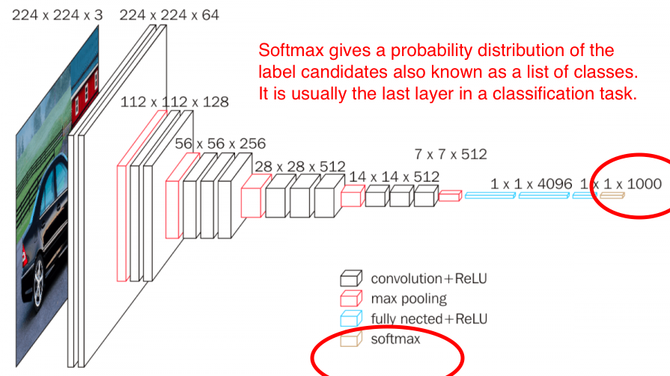
SoftMax

Slide 17
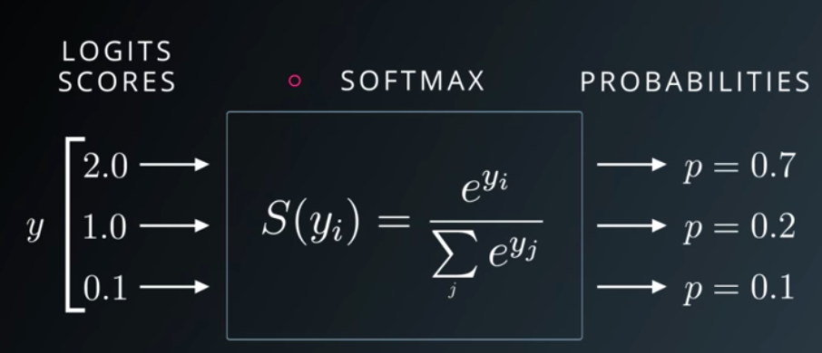
SoftMax

Slide 18
FaceNet
Learns a neural network that encodes a face image into a vector of 128 numbers.
By comparing two such vectors, you can then determine if two pictures are of the same person.
The FaceNet model takes a lot of data and a long time to train. So we would following common practice in applied deep learning, that loading the weights that someone else has already trained.

Slide 19
The network architecture
The network architecture to be followed is the Inception model from Szegedy et al.
The key things we need to know are:
96x96 dimensional RGB images - input.
Inputs m face images as a tensor of shape (m,nC,nH,nW)=(m,3,96,96)
It outputs a matrix of shape (m,128)

Slide 20
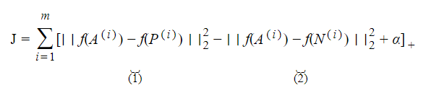
Encoding
Using “The triplet loss function”.
Useful functions:
tf.reduce_sum(), tf.square(), tf.subtract(), tf.add(), tf.maximum().

Slide 21
Face Verification
Step 1: Compute the encoding for the image. Using img_to_encoding()
Step 2: Compute distance with identity's image using np.linalg.norm()
Step 3: Open the door if dist < 0.7

Slide 22
Face Recognition
Step 1: Compute the target "encoding" for the image. Use img_to_encoding().
Step 2: Find the closest encoding
Initialize "min_dist" to a large value, say 100
Compute distance between the target "encoding" and the current image from the database.
If this distance is least,then set min_dist to dist, and identity to name.

Slide 23
References
https://www.coursera.org/learn/machine-learning
https://towardsdatascience.com/face-recognition-for-beginners-a7a9bd5eb5c2
https://www.coursera.org/learn/convolutional-neural-networks/home/week/1
https://learn.verzeo.in/

